Slide 1


Welcome to Communication Skills part 1 (CS1)
Week 1: Module Introduction

Slide 2
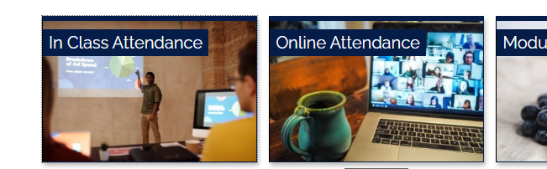

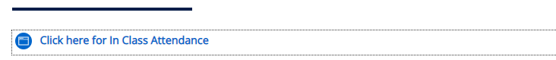

Registering your in Class attendance
Step 1: Ensure you are logged into the ARUL-Wi-Fi.
The password is: 1nt3rn3t@Arul
Step 2: Login to the VLE and go to the module page for your class.
Step 3: Click on In Class attendance
Step 4: Click on the link highlighted in blue. The word submitted will appear on your screen if you have followed the procedure
Step 5: Repeat this process for your AM/PM class

Slide 3

Your contacts
Lecturer:
Email:
Module leader: Jay Joseph
Email: jay.joseph@london.aru.ac.uk
This Photo by Unknown Author is licensed under CC BY-SA-NC
Notes:
Please type in your name and email ID here.

Slide 4

Session objectives: Week 1
By the end of this session, you will have:
Discussed the themes, learning objectives and resources associated with the Communication Skills 1 (CS1) module.
Looked at the CS1 assessment details and marking criteria.
Learned how to access lesson materials, coursebook and other resources on VLE.
Shared existing knowledge about reflective writing using a game and discussion activity.

Slide 5

Module details

Slide 6
Your expectations and plans
Work in groups of 3 or 4. Introduce yourself to others and then discuss the following:
Your expectations when you joined ARUL?
What do you think will be covered in CS1 module?
Adjustments and arrangements you have made (personal, work and others) to meet the demands of starting a degree course.
Where do you see yourself in five or six years’ time?

Slide 7
CS1 module aims
The CS1 module is designed to:
Teach you the basics of reflective practice and how to write a 1500-word reflective paper.
Prepare you for other modules at Level 3 and beyond.
Teach you how to effectively structure a paragraph and sections of longer written works.
Provide practical tips and guidance on electronic writing (e.g., formatting and structuring a Word document).

Slide 8
How this module fits into your studies
The module is designed to teach you how to write a reflective paper/practice, which will feature regularly throughout your studies and in wider contexts as well.
To help you with this module, you’ll have sessions on paragraphing, cohesion & coherence, planning & draft writing, editing & proofreading, citations and referencing, and feedback.
You’ll also have sessions on foundational concepts relating to academic writing such as formality and language.
Lastly, you’ll have sessions involving practical digital writing skills, including MS Word.

Slide 9
How this module fits into Level 3
The 1st part of this module is designed to work in combination with the 2nd part scheduled for the second trimester of your Foundation year.
Communication Skills part 1 (CS1)
Written communication
(Reflective writing)
Communication Skills part 2 (CS2)
Verbal communication
(Seminar discussion)
Notes:
Essentially, written and verbal academic communication skills.

Slide 10
How this module fits into Level 3
The Communication Skills module is also designed to support, and be supported by your other foundational modules:
Research Skills
1 & 2
Data Skills
1 & 2
Prof. Dev. Skills
1 & 2
Notes:
Provide some description of the skills / themes developed by this module that tie into others at L3, and vice versa.
All four modules have two parts 1 and 2, part 1 taught in their first trimester and part 2 in the second.

Slide 11
Employability and Reflective writing skills - 1
Reflective writing can be considered a skill in-and-of itself (especially in graduate-level roles).
You are expected to develop a host of related skills by the end of this module, including:
Attention to detail
Self-assessment and self-management skills
Information structuring and team-working
Language and formality skills
(to be continued)

Slide 12

Employability and Reflective writing skills - 2
Describing, analysing and evaluating events / situations
Interpretation and explanation skills
Devising action plans
Practical IT skills
Time management skills
Problem-solving skills and
Organisation skills

Slide 13

Activity 1: Module info quiz 1 - Introduction
Open the ARUL Mobile app OR VLE
Go to Communications Skills 1 > ‘Week 1’
Answer Activity 1 - Module Information Quiz 1 (Module aims + scope)
Notes:
This activity is designed to measure student expectations of the module and check their understanding of key systems / processes introduced so far. Lecturers should allow scope for discussion of answers at the end of the activity.

Slide 14

Assessment

Slide 15
Assessment: | Coursework – Writing a reflective paper
Assessment element / code: | Communication Skills Part 1 / 01o)
Academic year: | 2022/23
Trimester: | 3
Module title: | Skills for Higher Education
Module code: | MOD008861
Level: | 3
Module leader: | Jay Joseph
Word limit: | 1,500 words (excluding Reference list and other items listed in rule 6.75 of the Academic Regs)
Assessed learning outcomes: | 1 – 4
Submission deadline: | This assignment must be received by (please check Assessments and Assessment Guidance tile on VLE).

Slide 16
Assessment
Task summary:
Produce a 1500-word reflective writing that describes, evaluates, and analyses an aspect of your student life in ARUL.
Choose only one of the following aspects of your ARUL student life for your reflective writing:
1. Materials and activities used in your lessons/lectures
2. ARUL campus facilities and amenities
3. Involvement and participation in your lessons/lectures
Following Gibbs’ 6-element reflective model (covered in weeks 3 – 7 on the course), students are expected to reflect on the chosen aspect and produce a work that has the six elements namely Description, Feelings/thoughts, Evaluation, Analysis, Conclusion, and Action plan.

Slide 17
Assignment structure
Sections | Approximate Wordcount
1. Title page (Module name & code, essay title, SID & wordcount | NA
2. Contents page | NA
3. Introduction | 150 words
4. Description of the chosen topic | 225 words
5. Feelings / thoughts | 225 words
6. Evaluation | 225 words
7. Analysis | 225 words
8. Conclusion | 225 words
9. Action plan | 225 words
10. References | NA

Slide 18
Marking criteria - 1
Task fulfilment – 25%
Providing relevant and supportive ideas
Evidence of reflective practice / elements
Evidence of learning and development and how this is put into practice

Slide 19
Marking criteria - 2
Coherence and cohesion – 25%
Overall organisation and logical progression
Use of linking / signposting
Focus and development of paragraphs

Slide 20
Marking criteria - 3
Language – 25%
Range and accuracy of vocabulary
Range and accuracy of sentence structures
Genre and formality

Slide 21
Marking criteria - 4
Academic conventions – 25%
Evidence of research and use of sources
Standards of in-text citations and reference list
Use of mechanics (spelling, formatting, punctuation etc.)

Slide 22
Activity 2: Module info quiz 2 - Assessment
Open the ARUL Mobile app / VLE
Go to Communications Skills 1 > ‘Week 1’
Answer the Module Information Quiz 2 (Assessment)
Notes:
This activity is designed to measure student expectations of the module assessment and check their understanding of key systems / processes introduced so far. Lecturers should allow scope for discussion of answers at the end of the activity.

Slide 23

Break: max. 15 mins

Slide 24

Resources

Slide 25
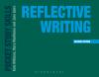
Key module resources
Module Information tile:
Scheme of work + resources list
CS1 contact list
Assessments & Guidance tile:
Assessment brief
Sample reflective paper(s)
Assessment submission link
Kortext (sidebar / app):
Main reading for the course Reflective Writing (2020) By Kate Williams, Mary Woolliams & Jane Spiro. Bloomsbury Publishing PLC
Notes:
Please provide a quick live demonstration of how students can access these resources.

Slide 26
Resources for sessions
Learning Resources tile:
Academic Skills (also posted under relevant weekly tiles)
Kortext (how to access / how to use)
Weekly session tiles:
Lecture slides
Activity documents
Mandatory independent study instructions / documents
Optional extra videos / articles / resources etc.
Notes:
Please provide a quick live demonstration of how students can access these resources.

Slide 27

To gain the most out of CS1

Slide 28
Independent study
Completing homework is vital for passing the module, and will feed directly into the assessment.
Full-time courses require students to complete up to 7 hours of additional study and reading for every module each week.
Most weeks, you’ll be expected to complete the following
Mandatory: 1 x reading task, 1 x quiz, 1 x writing activity, preparatory resources for the following week
Optional: Videos, articles, websites, guides etc.

Slide 29
Progress monitoring
We’ll look at the data on these things to ensure you’re doing what’s required to pass the module:
Class attendance
Kortext reading frequency and focus
CS1 VLE page engagement (logins / use of resources etc.)
Regular writing activities (examples discussed in class)
Wider homework participation

Slide 30
Activity 3: Module info quiz 3 - Resources
Open the ARUL Mobile app / VLE
Go to Communications Skills 1 > ‘Week 1’
Answer the Module Information Quiz 3 (Resources)
Notes:
This activity is designed to measure student expectations of the module resources and check their understanding of key systems / processes introduced so far. Lecturers should allow scope for discussion of answers at the end of the activity.

Slide 31
Activity 4: Think-Pair-Share
Think about your answers to the questions on the next slide for approximately 5 minutes.
Pair up with your neighbour and discuss your answers to these questions for 10 mins.
Then. share your answers with the rest of the class.

Slide 32
Think-Pair-Share Qs
What do you understand by ‘reflection?’
Do you reflect? When and how often do you reflect? What are the benefits of reflecting?
Is reflective practice a useful skill in academic world? Why/how?
Why is reflective practice and reflective writing important for employability?
Think of an important event/situation/thing you had/were/did in the past. Describe, evaluate and analyse it. How do you feel about it now? How differently would you do it again? (Note: You will use this for your Week 1 HW writing activity.)

Slide 33

Graduate Attributes – 4 A’s
Notes:
The Graduate attributes have been introduced to help students come out as employable graduates; some of them may have seen this in the Welcome week. GO through them if time allows.

Slide 34
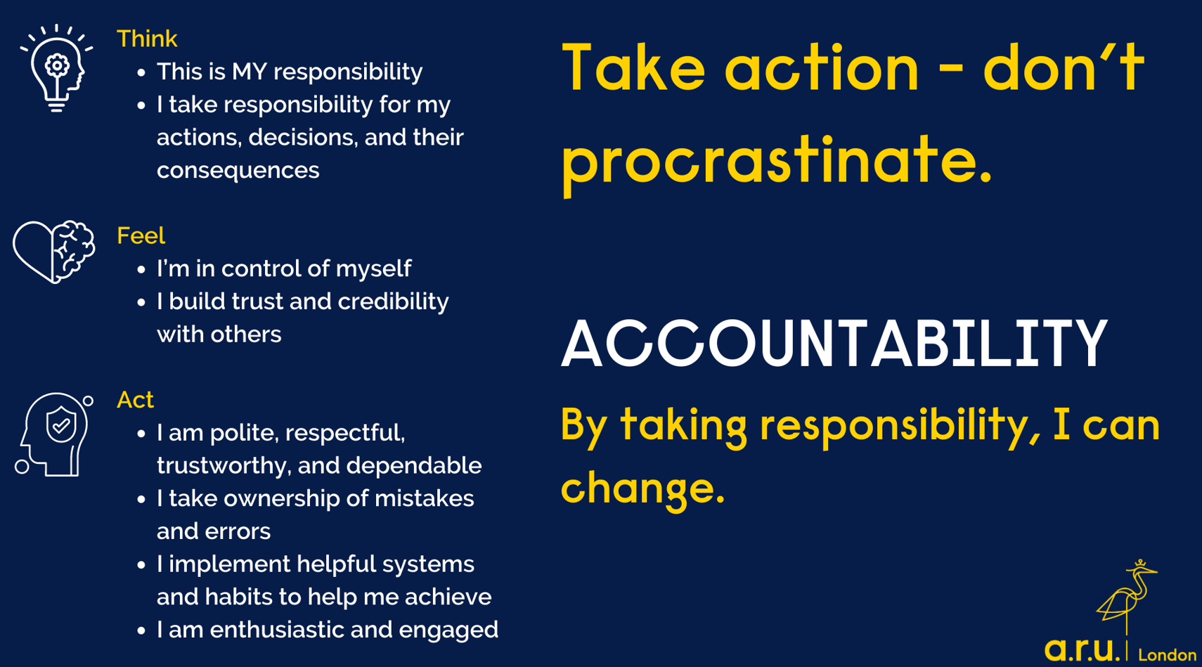

Slide 35


Slide 36
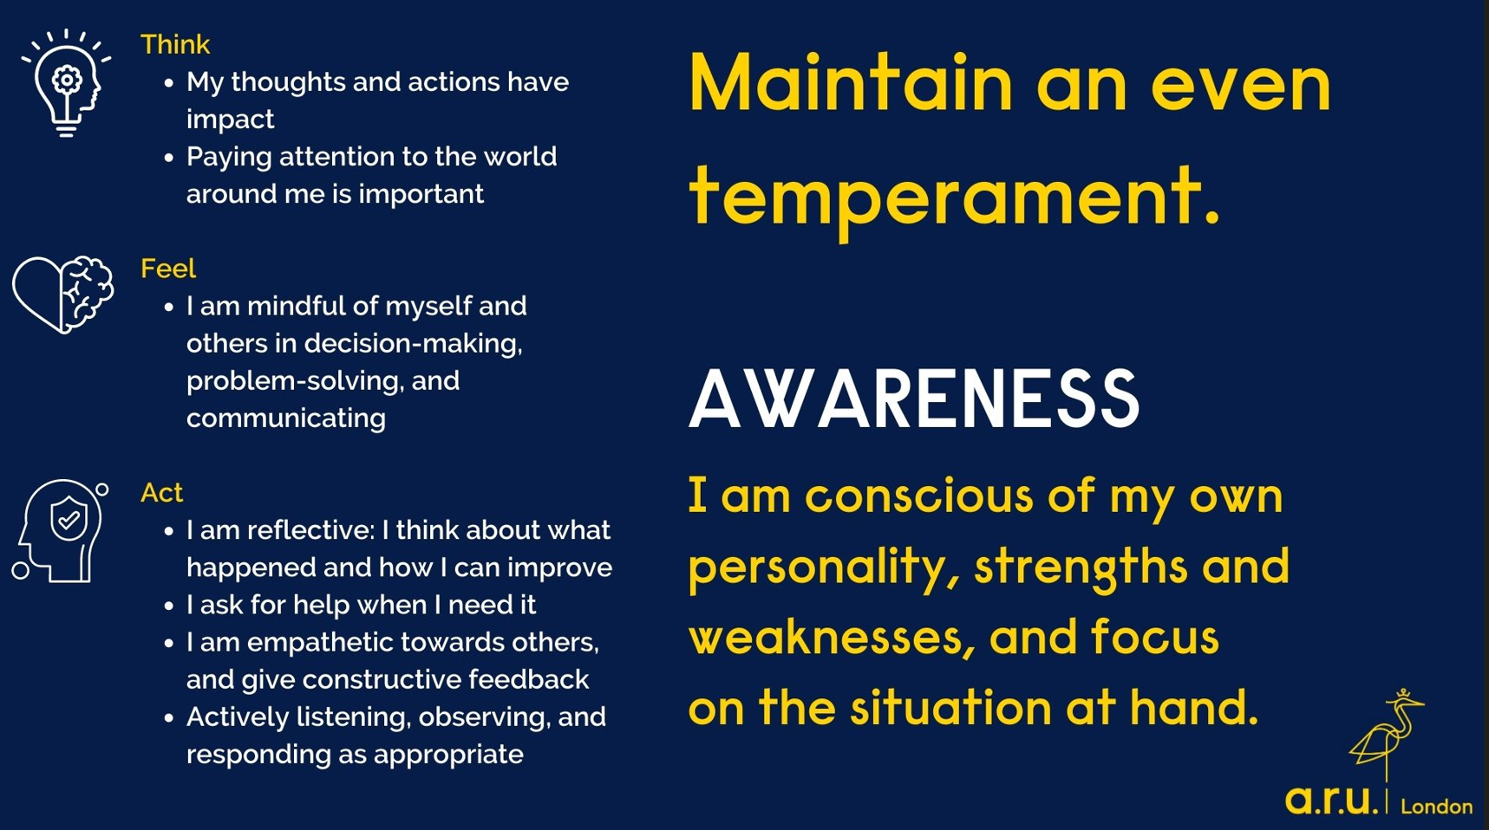

Slide 37


Slide 38

Let’s revise what you already know

Slide 39
Game time - Kahoot
https://create.kahoot.it/details/3d6156fd-f168-4c42-b974-cdce56a6479a
Notes:
If you haven’t used Kahoot before:
OPEN an account on Kahoot – it’s free and quick. You can also play as a GUEST if you have not logged in.
When you click on the link above (or copy and paste), it takes you to a page on Kahoot titled ‘Reflective writing.’
Choose the mode to play the game – Classic mode (one device per person) OR Team mode (pairs or groups).
Then you see another page with the Game PIN and link for students to use (www.kahoot.it).
Ask students to type the link www.kahoot.it onto their browser. They need to enter the PIN and their name to log in to the game.
Once they have done that, you should see their details on your screen. When they have all logged in to the game, you can START the game.
Click on NEXT to go to the next question, SKIP to skip a question etc.
At the end of the game, they will see who scored the most etc.

Slide 40
In-class writing practice
Write/type a small paragraph of about 50-100 words on the following:
How was the learning session today? What did you enjoy? What could you have done better? (10 minutes)
After 10 minutes, work in pairs, exchange your paragraph with your partner and tell each other one good thing about their writing, and one area they can do better next time .

Slide 41


Slide 42
Independent study
Go to the ‘Independent study’ section under Week 1 tile.
READ: pp. 2-6 on Kortext / PDF
ANSWER: Homework Quiz – on VLE Week 1
WRITE: Week 1 Independent Study Writing Activity
WATCH: Videos in ‘Week 1 Preparation Resources’

Slide 43
Notes on HW
READ: You may not have access to the book yet, so the reading pages have been uploaded on VLE as PDF
Take the quiz after reading the above pages, the answers are in the reading.
WRITE: You do not have to send your writing to your lecturer; you may write this in paper or on your laptop; bring it to class next CS1 lesson.
WATCH: Videos in ‘Week 1 Preparation Resources’

